Slide 1
Linear Regression
By Joash Colaco

Slide 2
Agenda
Define Linear Regression
Model Outputs
What is a Good Model?
Pre-Modeling Techniqus

Slide 3
What is Linear Regression?

Slide 4
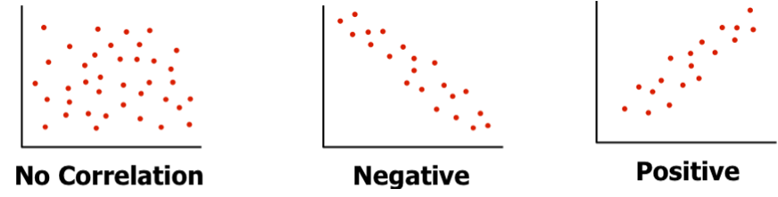
Correlation
Simply the relationship between two or more variables!
Ranges between -1 and 1

Slide 5
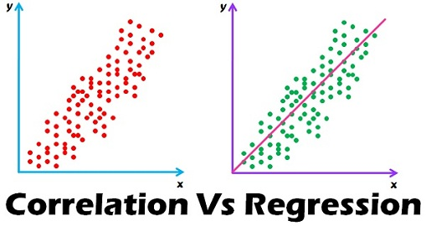
Correlation

Slide 6
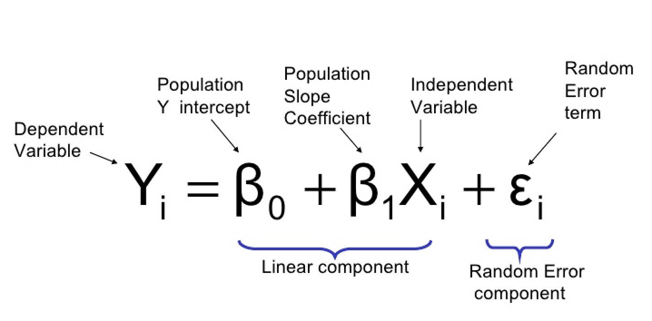
Linear Regression
Models the correlation between two or more features by fitting linear equation to the data
Equation is as follows:

Slide 7
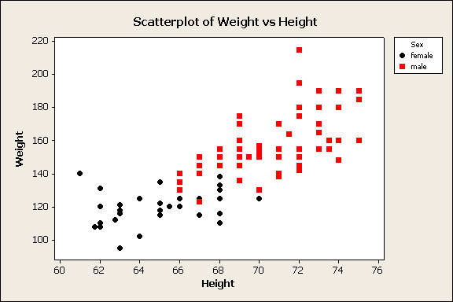
Linear Regression
When to use?
Prediction purposes
Correlations are hypothesized/proven to be linear
Eg: Height vs. Weight, Hours Studied vs. Grade, Lotsize vs. House Price

Slide 8
Linear Regression

Slide 9
Model Outputs

Slide 10
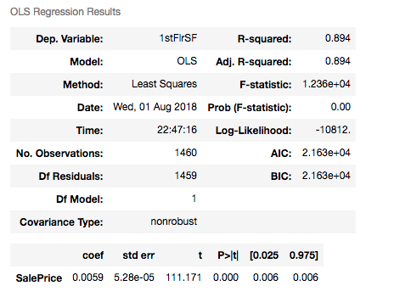

Slide 12
R-squared
R-squared = explained variation / total variation
Determines how much of the variation in the data is explained by the model
Higher R-squared always good?
Higher R-squared = better linear regression model
Too high R-squared means overfitting training data
What happens to the value of R-squared if you add more features to the model?

Slide 14
P-value
M

Slide 16
Coefficient
M

Slide 18
F-Stat

Slide 19
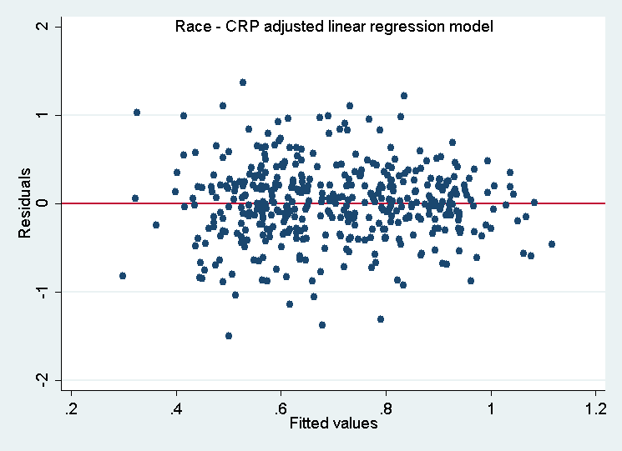
Residual Plot
Residual = predicted value – actual value
Three rules for residuals
Normally distributed
Constant Variance
Independent
Notes:
https://www.google.ca/url?sa=i&source=images&cd=&cad=rja&uact=8&ved=2ahUKEwiyq6Kopc3cAhVh2oMKHTOiD8QQjRx6BAgBEAU&url=https%3A%2F%2Fthesalience.wordpress.com%2Fpsychology-101%2Fresearch-methods-in-psychology%2Fcorrelations%2F&psig=AOvVaw27LgH72MEqZYWl3tw1dqn6&ust=1533262171316904

Slide 20
Residual Plot
How to tell if normally distributed?
QQ-Plot
Assess if data theoretically comes from normal distribution
Notes:
https://www.google.ca/url?sa=i&source=images&cd=&cad=rja&uact=8&ved=2ahUKEwiyq6Kopc3cAhVh2oMKHTOiD8QQjRx6BAgBEAU&url=https%3A%2F%2Fthesalience.wordpress.com%2Fpsychology-101%2Fresearch-methods-in-psychology%2Fcorrelations%2F&psig=AOvVaw27LgH72MEqZYWl3tw1dqn6&ust=1533262171316904

Slide 21
What defines a good LR model?

Slide 22
Do I have a good model?
P-value for F-statistic less than 0.05
Assess if data theoretically comes from normal distribution

Slide 23
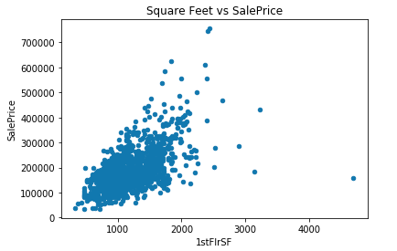
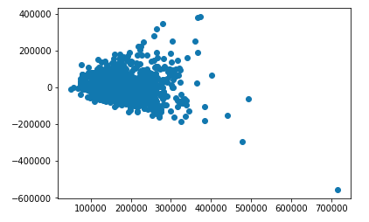
Residual Plot
Notes:
https://www.google.ca/url?sa=i&source=images&cd=&cad=rja&uact=8&ved=2ahUKEwiyq6Kopc3cAhVh2oMKHTOiD8QQjRx6BAgBEAU&url=https%3A%2F%2Fthesalience.wordpress.com%2Fpsychology-101%2Fresearch-methods-in-psychology%2Fcorrelations%2F&psig=AOvVaw27LgH72MEqZYWl3tw1dqn6&ust=1533262171316904

Slide 24
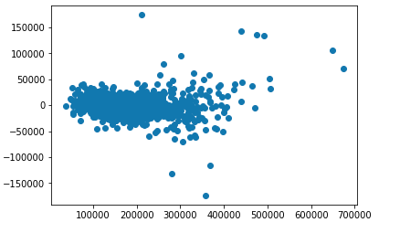

Residual Plot
Residual Plot for Model with all features
Residual Plot for Model with 6.5 percentile of features
Notes:
https://www.google.ca/url?sa=i&source=images&cd=&cad=rja&uact=8&ved=2ahUKEwiyq6Kopc3cAhVh2oMKHTOiD8QQjRx6BAgBEAU&url=https%3A%2F%2Fthesalience.wordpress.com%2Fpsychology-101%2Fresearch-methods-in-psychology%2Fcorrelations%2F&psig=AOvVaw27LgH72MEqZYWl3tw1dqn6&ust=1533262171316904

Slide 25
To-do before modeling

